Slide 1

STEPS IN DEVELOPING AN EXPERT SYSTEMS

Slide 2
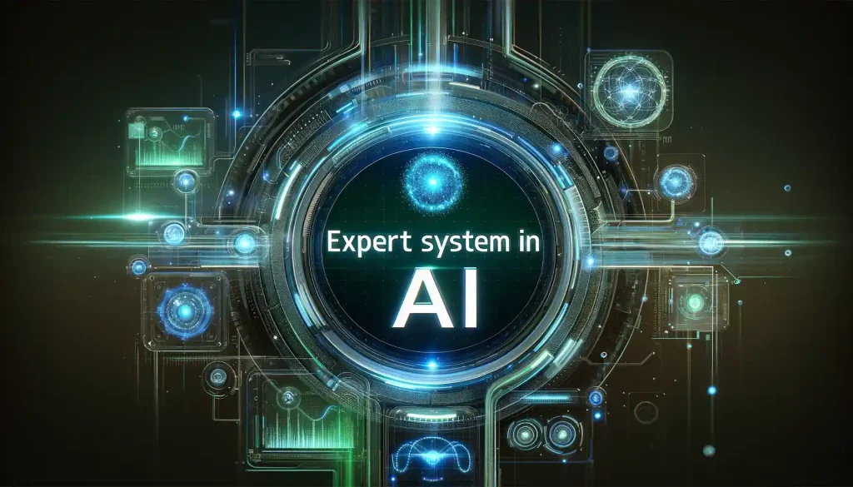

What is an Expert System?
A computer program that thinks like a human expert.
The expert systems are the computer applications developed to solve complex problems in a particular domain, at the level of extra-ordinary human intelligence and expertise.
It solves difficult problems in a very specific area (like medical diagnosis or fraud detection).
It uses a database of rules and facts called the 'Knowledge Base' taken directly from human experts.
It uses a Inference Engine to reason and figure out the best answer based on the rules.

Slide 3
Characteristics of Expert Systems
High performance
Understandable
Reliable
Highly responsive
Capabilities of Expert Systems
The expert systems are capable of −
Advising
Instructing and assisting human in decision making
Demonstrating
Deriving a solution
Diagnosing
Explaining
Interpreting input
Predicting results
Justifying the conclusion
Suggesting alternative options to a problem

Slide 4
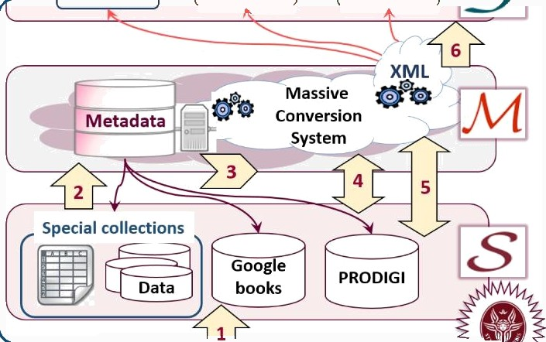



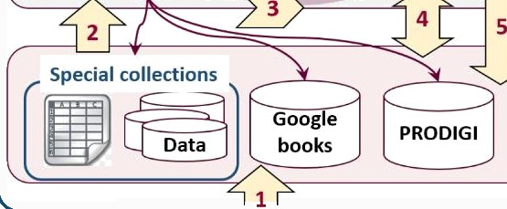
The Three Core Components
XML
’x‹
J
Q
Knowledge Base
The 'library'.
A collection of facts, rules, and smart guesses about the subject.
Inference Engine
The 'brain'.
This part uses logic to apply the rules and draw conclusions.
User Interface
The 'console'.
How non-experts input data, ask questions, and receive clear advice.

Slide 5
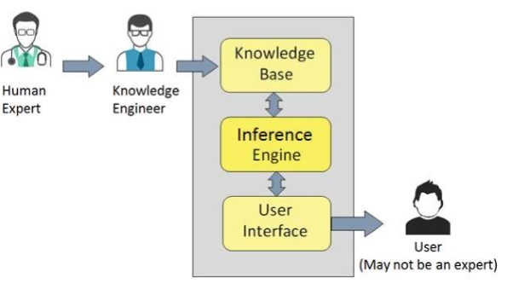

Slide 6
The 6 Steps:
This is the process of building the expert's knowledge into the machine.
Define the Problem
Knowledge Acquisition
Knowledge Representation
Implementation (Building the System)
Testing & Validation
Deployment & Maintenance

Slide 7
Step 1: Define the Problem
Is the scope clear? The problem must be narrow (e.g. only diagnosing a few blood diseases).
Are experts available? You must be able to work closely with human experts who know the answers.
Is it logical? The problem should require logical thinking and rules, not just simple math or common sense.
Is it worth the time? The problem should be hard enough to need an ES, and the solution must be highly valuable.

Slide 8



Step 2: Knowledge Acquisition (Getting the Facts)
The success of any expert system majorly depends on the quality, completeness, and accuracy of the information stored in the knowledge base.
What is Knowledge?
The data is collection of facts. The information is organized as data and facts about the task domain. Data, information, and past experience combined together are termed as knowledge.
Components of Knowledge Base
The knowledge base of an ES is a store of both, factual and heuristic knowledge.
Factual Knowledge: It is the information widely accepted by the Knowledge Engineers and scholars in the task domain.
Heuristic Knowledge: It is about practice, accurate judgment, ones ability of evaluation, and guessing.
Of the project time can be spent here.

Slide 9
Step 3: Knowledge Representation (Writing the Rules)
It is the method used to organize and formalize the knowledge in the knowledge base. It is in the form of IF-THEN-ELSE rules.
IF-THEN Rules (Production
Rules)
This is the most common and simplest way to store knowledge. It's a series of conditional statements that the system can follow.
Example(Medical):
IF (patient has fever)
AND (patient has cough)
THEN (suggest flu test)
Frame-Based Systems
Knowledge can also be stored as object—like structures called **Frames**. Each frame has slots for specific details about an item.
Example: A "Car Frame" has slots for "Engine Type," "Oil Level," and "Tire Pressure."
This model is great for grouping data and understanding relationships.

Slide 10
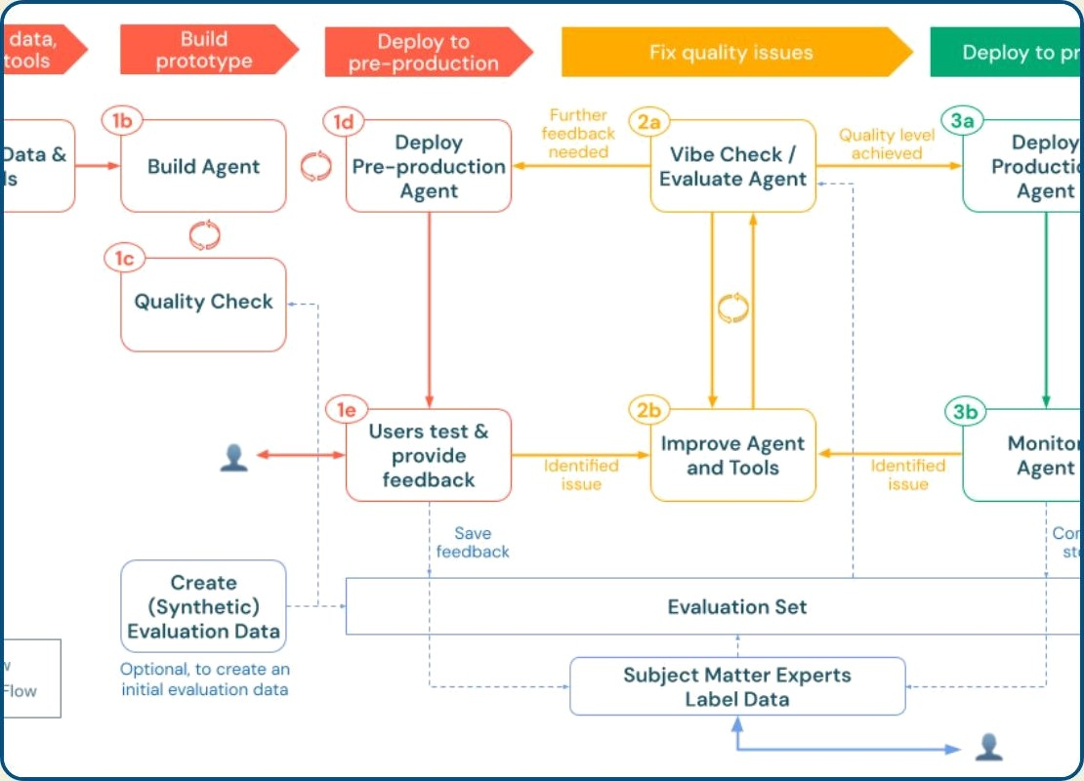
Step 4: Implementation (Building the System)
Coding the Knowledge:
The rules are translated into code, often using an Expert System Shell(a ready— made framework).
Choosing the Engine:
Decide how the system will reason (e.g., Forward Chaining or Backward Chaining).
Designing the Interface:
Make sure the system is easy for the end—user to interact with.

Slide 11

Step 5 & 6: Testing, Rollout, and Maintenance
Testing & Validation
The system is tested against many past cases. The human expert must approve the system's answers. This is a cycle of testing, refining the rules, and testing again until the system is reliable.
Deployment & Maintenance
The system is used in the real world. It needs constant updates to the Knowledge Base as new research, rules, or knowledge emerges. An outdated expert system is dangerous.

Slide 12
Beyond Rules: Different Types of ES

Slide 13
Why Expert Systems Matter (and their Limits)
Advantages
Consistency: They make the same, unbiased decision every time.
Availability: They work 24/7 and never get sick or retire.
Knowledge Preservation: They save valuable expert knowledge that might otherwise be lost.
Limitations
No Common Sense: They cannot reason outside of their defined rules.
High Cost: Developing the initial Knowledge Base is very expensive and time—consuming.
Limited Learning: Traditional ES do not learn automatically; they require manual updates.

Slide 14
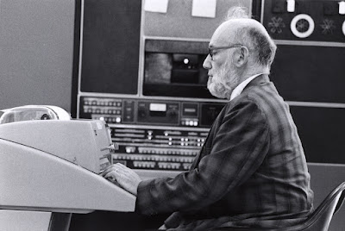
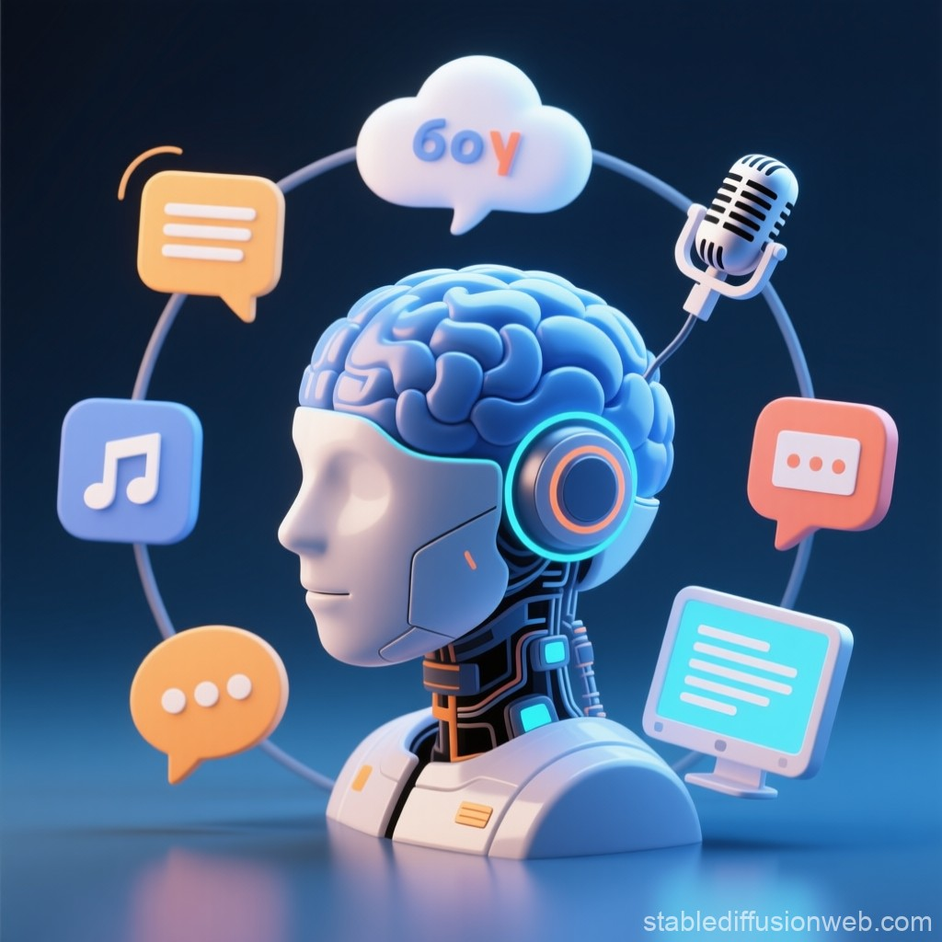

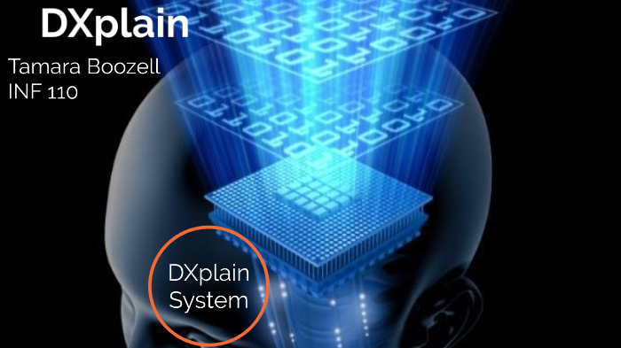




Classic Examples in Action
DENDRAL (1960s)
Identified chemical structures.
MYCIN (1970s)
Diagnosed infectious blood diseases.
XCON / R1 (1980s)
Configured computer orders.
DXplain (1980s)
Lists possible diseases from symptoms.

Slide 15
Medical & Healthcare Systems
Modern and classic systems focused on clinical decision support and diagnosis.
DXplain: A clinical support system that suggests potential diseases based on a doctor's findings and patient symptoms.
CaDet: An expert system specialized in the early detection and identification of various types of cancer.
PXDES: Assists in identifying the type and level of lung cancer using patient images and limited data.
CADUCEUS: A medical diagnosis system designed to handle complex cases of infectious diseases.
PUFF: An expert system developed to diagnose lung diseases and monitor pulmonary function.
CASNET: One of the early systems used for diagnosing and treating various medical conditions, including glaucoma.

Slide 16
Business & Engineering Systems
These systems manage complex processes, from configuration to safety monitoring.
Mistral: A long-running monitoring system used for dam safety; it has been operational on several dams in Italy and abroad since the 1990s.
Alacrity: The first commercial strategy managerial advisory system, utilizing a complex knowledge base of over 3,000 rules.
XSEL: A specialized configuration system developed by Xerox to manage computer system orders without human intervention.
Hearsay: An early attempt to solve voice recognition through an expert systems approach by identifying phonemes in audio.
Software Frameworks (Shells)
"Shells" are expert systems without a pre-loaded knowledge base, allowing developers to build new ones.
Java Expert System Shell (JESS): A popular tool for building rule-based expert systems in the Java environment.
Vidwan: A shell used to reduce the effort and cost of developing new expert systems.
APES: An early expert system shell based on the Prolog programming language.

Slide 17


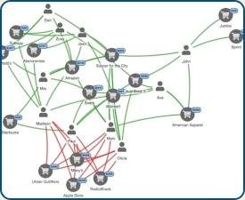

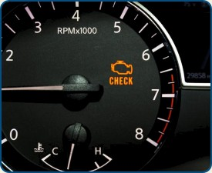
Expert Systems in Your Daily Life
Streaming | Banking | Customer Support | Automotive
The"Recommended for You" list uses | Rules-based systems detect and | Chatbots use rules to understand | Your car's onboard diagnostics
rules to suggest what to watch next. | flag suspicious transactions to preventfraud. | your problem and provide an instant answer. | system uses rules to identify a problem.

Slide 18
Applications of Expert System
The following table shows where ES can be applied.
Application | Description
Design Domain | Camera lens design, automobile design.
Medical Domain | Diagnosis Systems to deduce cause of disease from observed data, conduction medical operations on humans.
Monitoring Systems | Comparing data continuously with observed system or with prescribed behavior such as leakage monitoring in long petroleum pipeline.
Process Control Systems | Controlling a physical process based on monitoring.
Knowledge Domain | Finding out faults in vehicles, computers.
Finance/Commerce | Detection of possible fraud, suspicious transactions, stock market trading, Airline scheduling, cargo scheduling.

Slide 19
Resources
https://www.tutorialspoint.com/artificial_intelligence/artificial_intelligence_expert_systems.htm
https://www.simplilearn.com/tutorials/artificial-intelligence-tutorial/what-are-expert-systems-in-ai
https://www.mygreatlearning.com/blog/expert-systems-in-artificial-intelligence/

Slide 20


